Slide 1
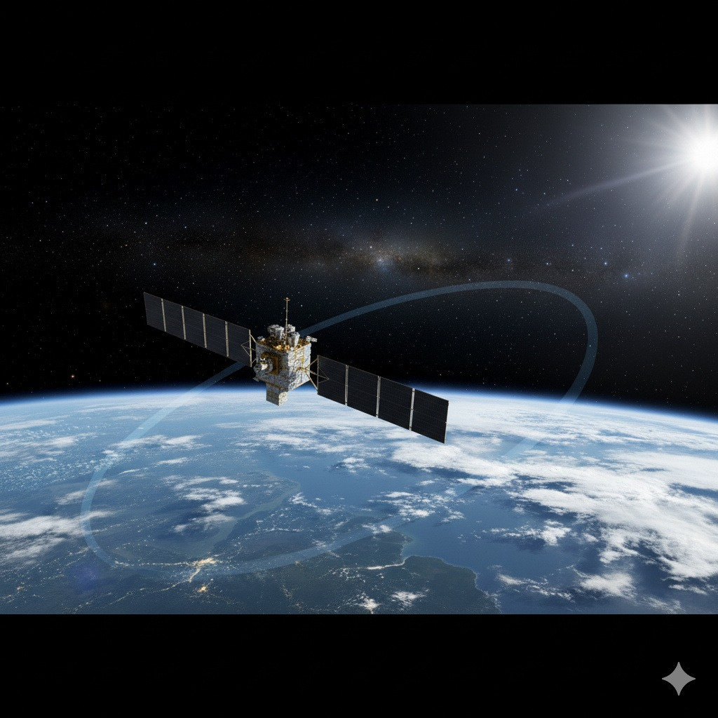
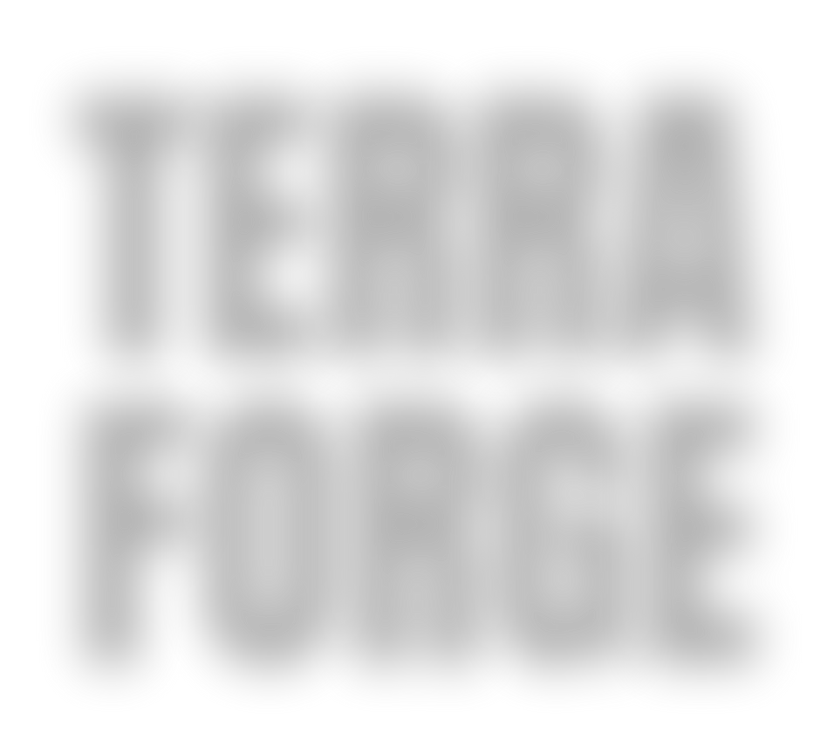

25 YEARS OF EARTH OBSERVATION .
TERRA FORGE
YOUR PARAGRAPH TEXT YOUR PARAGRAPH TEXT
LAUNCHED BY NASA ON DECEMBER 18, 1999, THE TERRA SATELLITE
IS THE FLAGSHIP OF THE EARTH OBSERVING SYSTEM. IT CARRIES FIVE
INSTRUMENTS THAT WORK TOGETHER TO MONITOR THE HEALTH OF
OUR PLANET BY COLLECTING DATA ON EARTH'S ATMOSPHERE, LAND,
OCEANS, AND RADIANT ENERGY. THIS LONG-RUNNING MISSION
PROVIDES CRUCIAL INSIGHTS INTO CLIMATE CHANGE AND THE IMPACT
OF HUMAN ACTIVITIES.

Slide 2
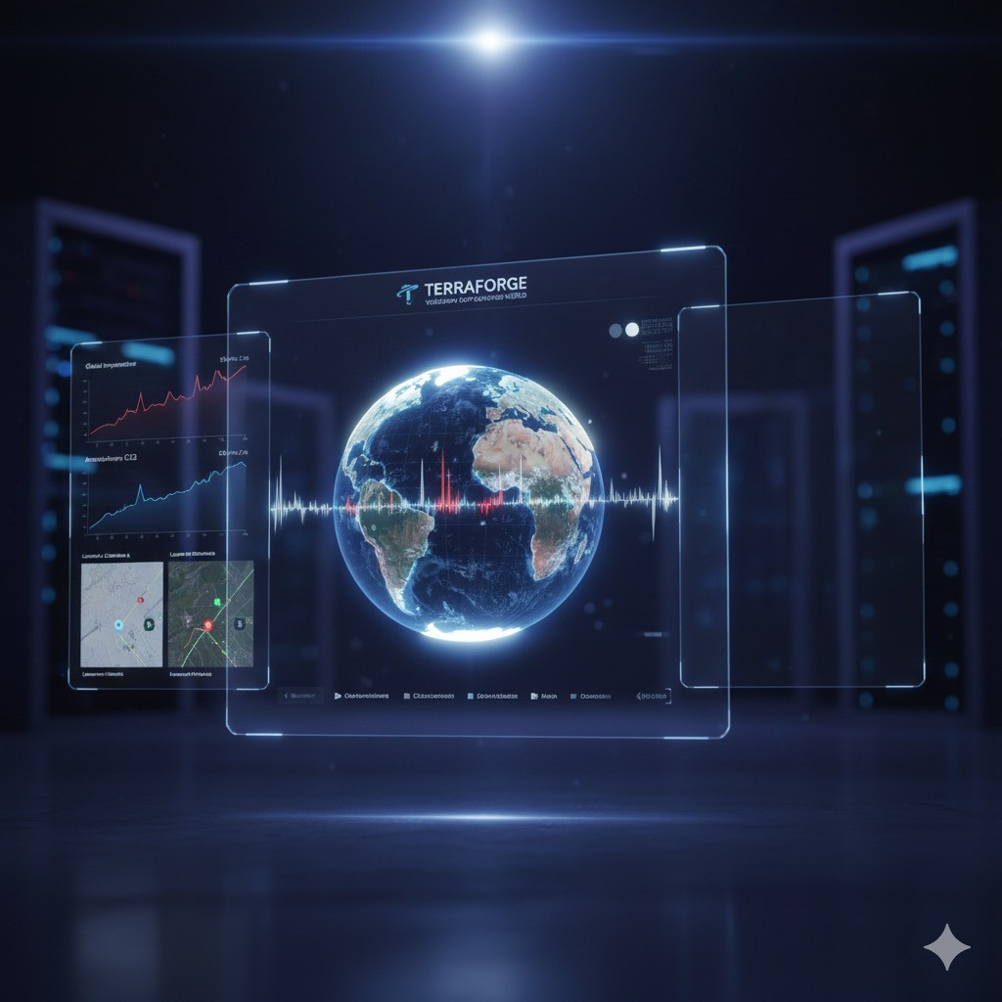
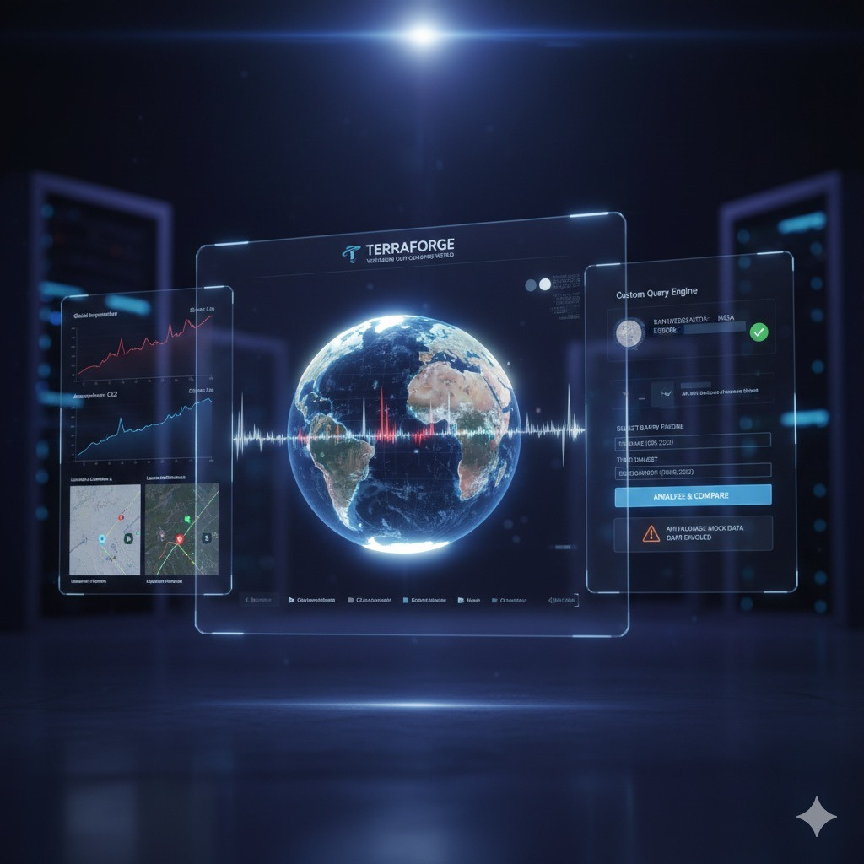


PROJECT OVERVIEW AND
VISION
Project Identity: TERRAFORGE is an interactive web platform designed to visualize 25 years of continuous Earth observation data. Data Scope: The project collects and presents vital data on Earth's atmosphere, land, oceans, and energy balance. Core Vision: The vision is to enable users to explore this extensive dataset to understand how our world is changing and how these changes impact everyone

Slide 3
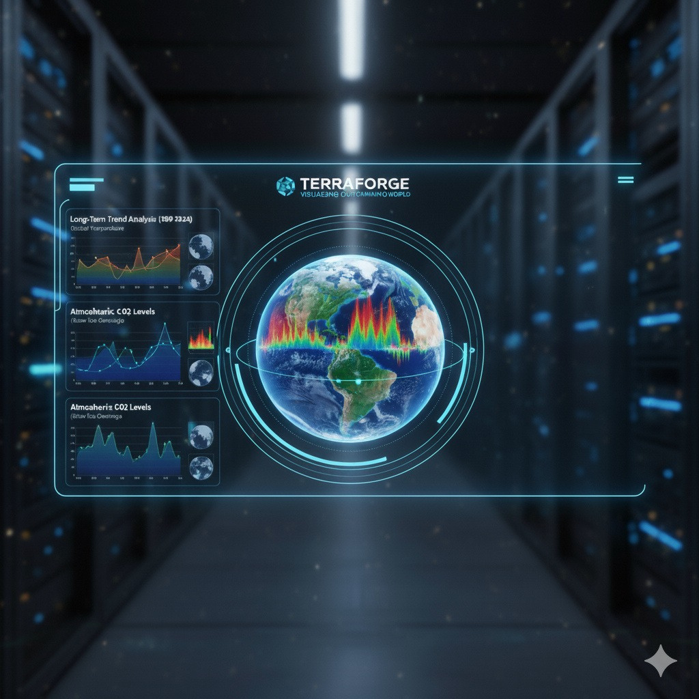
Core feature
LONG-TERMTRENDANALYSIS: THE PLATFORMPROVIDES INTERACTIVECHARTS THAT DISPLAY GLOBAL TRENDS FROM 1999 TO 2024 FOR KEY METRICS LIKE TEMPERATURE, CO2 LEVELS, ICE COVERAGE, AND VEGETATION.
CUSTOM DATA QUERY ENGINE: IT FEATURES A POWERFUL TOOL THAT ALLOWS USERS TO FETCH SPECIFIC SATELLITE DATA FOR ANY DATE, LOCATION, AND AREA OF INTEREST.
DUAL ANALYSIS MODES: THE QUERY TOOL SUPPORTS BOTH SINGLE LOCATION DEEP DIVES AND A COMPARATIVE MODE THAT CONTRASTS DATA BETWEEN TWO LOCATIONS USING CHARTS AND STATISTICS.
INTERACTIVE VISUALISATIONS: THE USER EXPERIENCE IS ENHANCED WITH IMMERSIVE 3D GLOBES FOR DATA VISUALISATION AND AN INTERACTIVE 2D WORLD MAP FOR EASY LOCATION SELECTION.

Slide 4
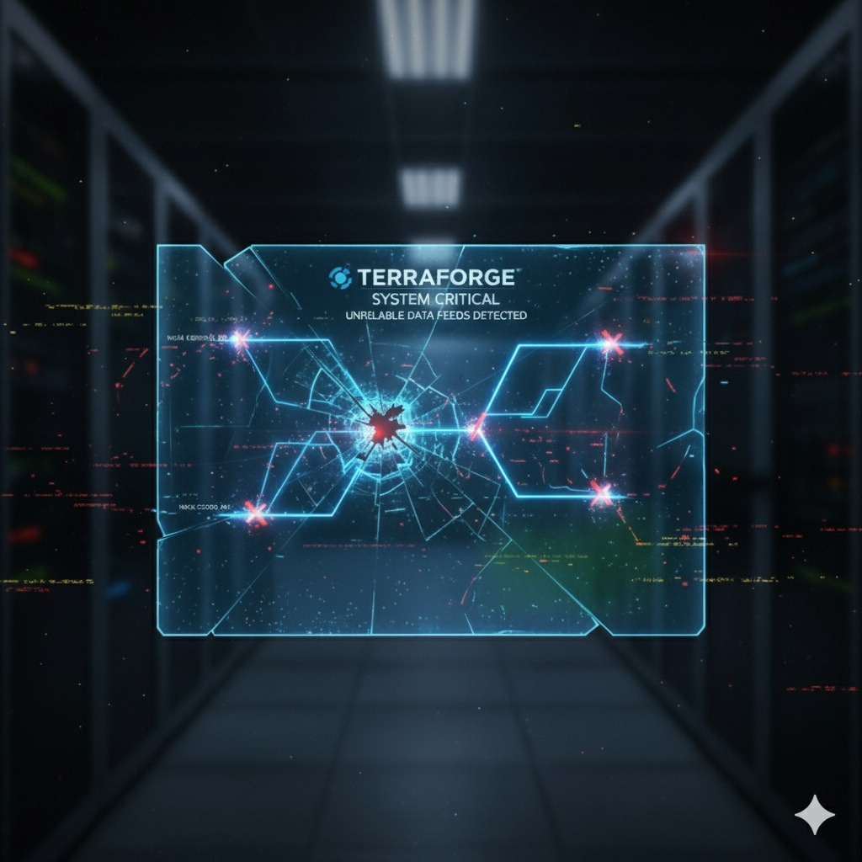
THE PROBLEMS WE FACED
TECHNICAL FOCUS:
API RELIABILITY:
A KEY CHALLENGE WAS THE POTENTIAL FOR API CALLS TO EXTERNAL DATA SOURCES TO FAIL, WHICH COULD DISRUPT THE USER EXPERIENCE.
DEFINE A SOCIETAL PROBLEM BUT HIGHLIGHTS TECHNICAL CHALLENGES ENCOUNTERED DURING DEVELOPMENT.
THE PROVIDEDDATA DOESNOT
DATA ACCESS COMPLEXITY:
ACCESSINGCERTAIN LIVE NASA
DATASETS REQUIRES COMPLEX AUTHENTICATION, POSING A CHALLENGE FOR A PUBLIC-FACING DEMONSTRATION TO OL.

Slide 5
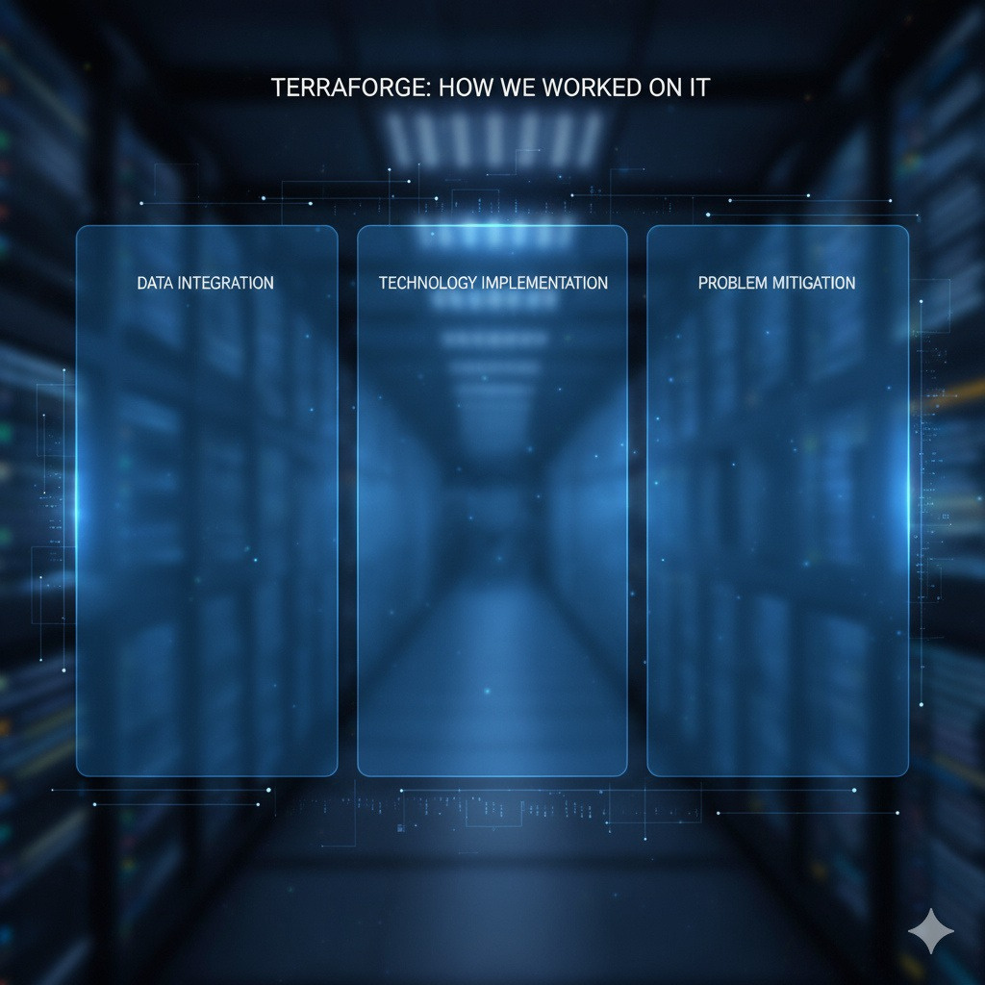
THE PROJECT WAS BUILT BY SOURCING AND INTEGRATING DATA FROM OFFICIAL ARCHIVES, PRIMARILY THE NASA EARTH OBSERVING SYSTEM DATA AND INFORMATION SYSTEM (EOSDIS).
KEY FRONTEND LIBRARIES WERE USED TO BUILD THE PLATFORM: CHART.JS FOR DATA CHARTS, THREE.JS FOR 3D GLOBES, AND LEAFLET.JS FOR THE INTERACTIVE MAP.
TO ENSURE STABILITY AND A SEAMLESS USER EXPERIENCE, A FALLBACK SYSTEM USING MOCK DATA WAS IMPLEMENTED TO HANDLE POTENTIAL API FAILURES OR AUTHENTICATION ISSUES.

Slide 6
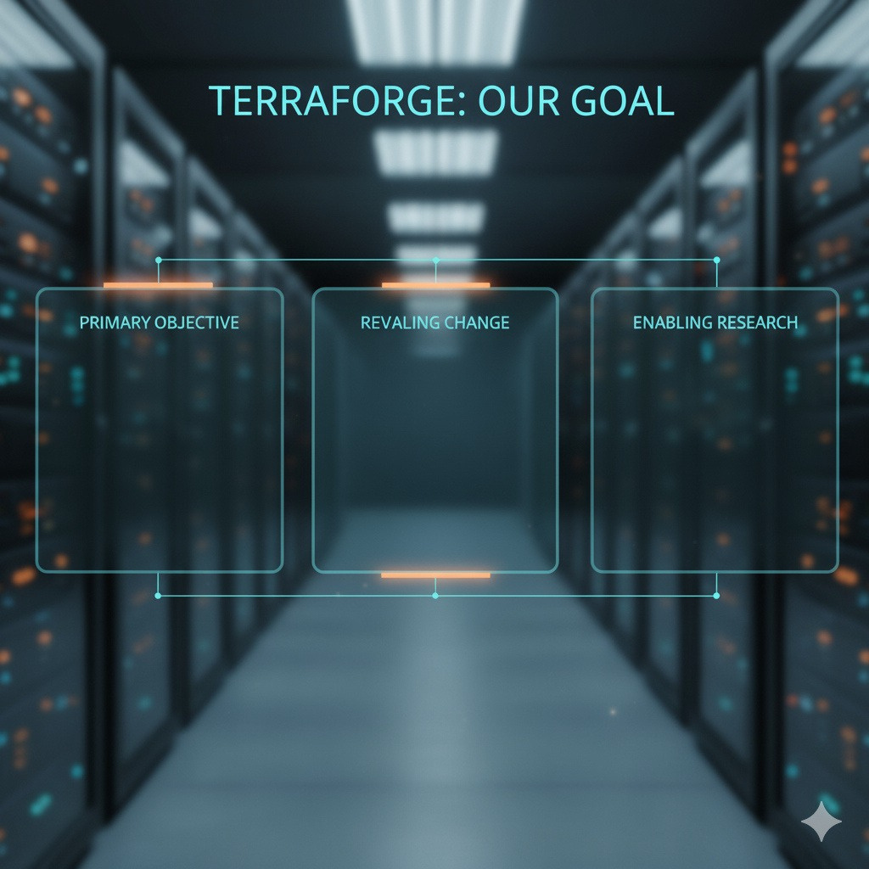
THE MAIN GOAL IS TO EMPOWER USERS TO EXPLORE AND UNDERSTAND 25 YEARS OF COMPLEX EARTH SCIENCE DATA THROUGH AN ACCESSIBLE AND INTERACTIVE INTERFACE
THE PROJECT AIMS TO PROVIDE TOOLS THAT HELP USERS VISUALIZE LONG- TERM TRENDS AND UNDERSTAND HOW OUR WORLD IS CHANGING OVER TIME.
A CORE GOAL IS TO FACILITATE USER- DRIVEN RESEARCH BY ALLOWING THEM TO PERFORM CUSTOM QUERIES FOR SPECIFIC DATES, LOCATIONS, AND AREAS OF INTEREST

